Slide 1
GRAPH ISOMORPHISM

Slide 2
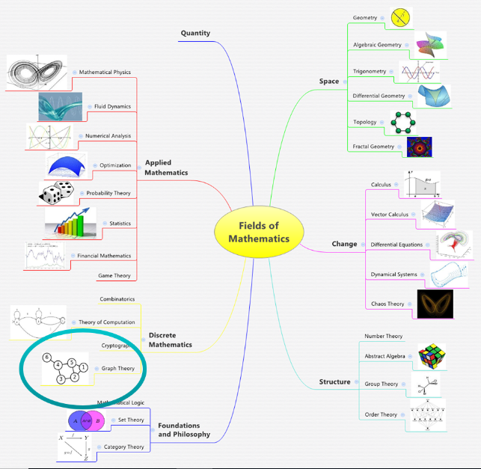
GRAPH THEORY

Slide 3
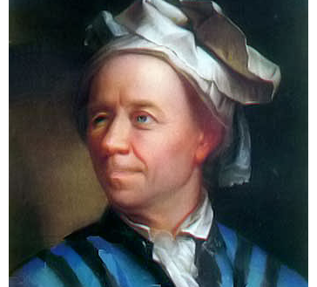
LEONHARD EULER
a blind man leading mathematics
Leonhard Euler, (born April 15, 1707, Basel, Switzerland—died September 18, 1783, St. Petersburg, Russia), Swiss mathematician and physicist
He not only made decisive and formative contributions to the subjects of geometry, calculus, mechanics, and number theory but also developed methods for solving problems in observational astronomy and demonstrated useful applications of mathematics in technology and public affairs.

Slide 4
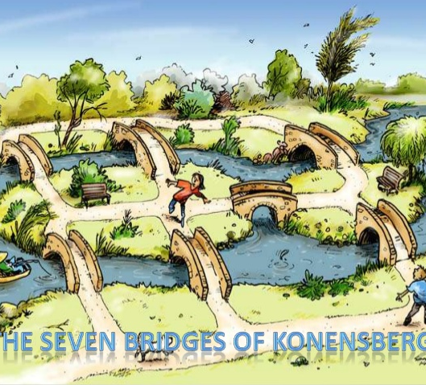
Königsberg bridge problem
The Königsberg bridge problem was an old puzzle concerning the possibility of finding a path over every one of seven bridges that span a forked river flowing past an island—but without crossing any bridge twice. Euler argued that no such path exists

Slide 5
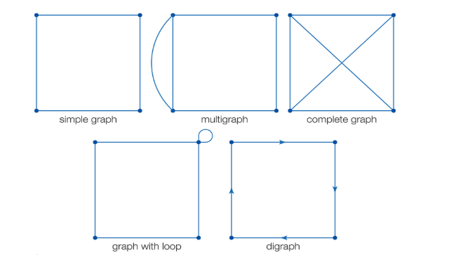
TYPES OFGRAPH

Slide 6
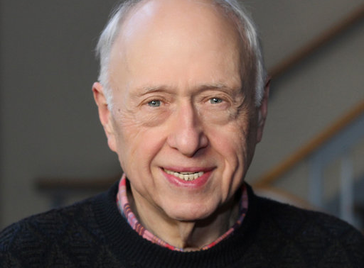
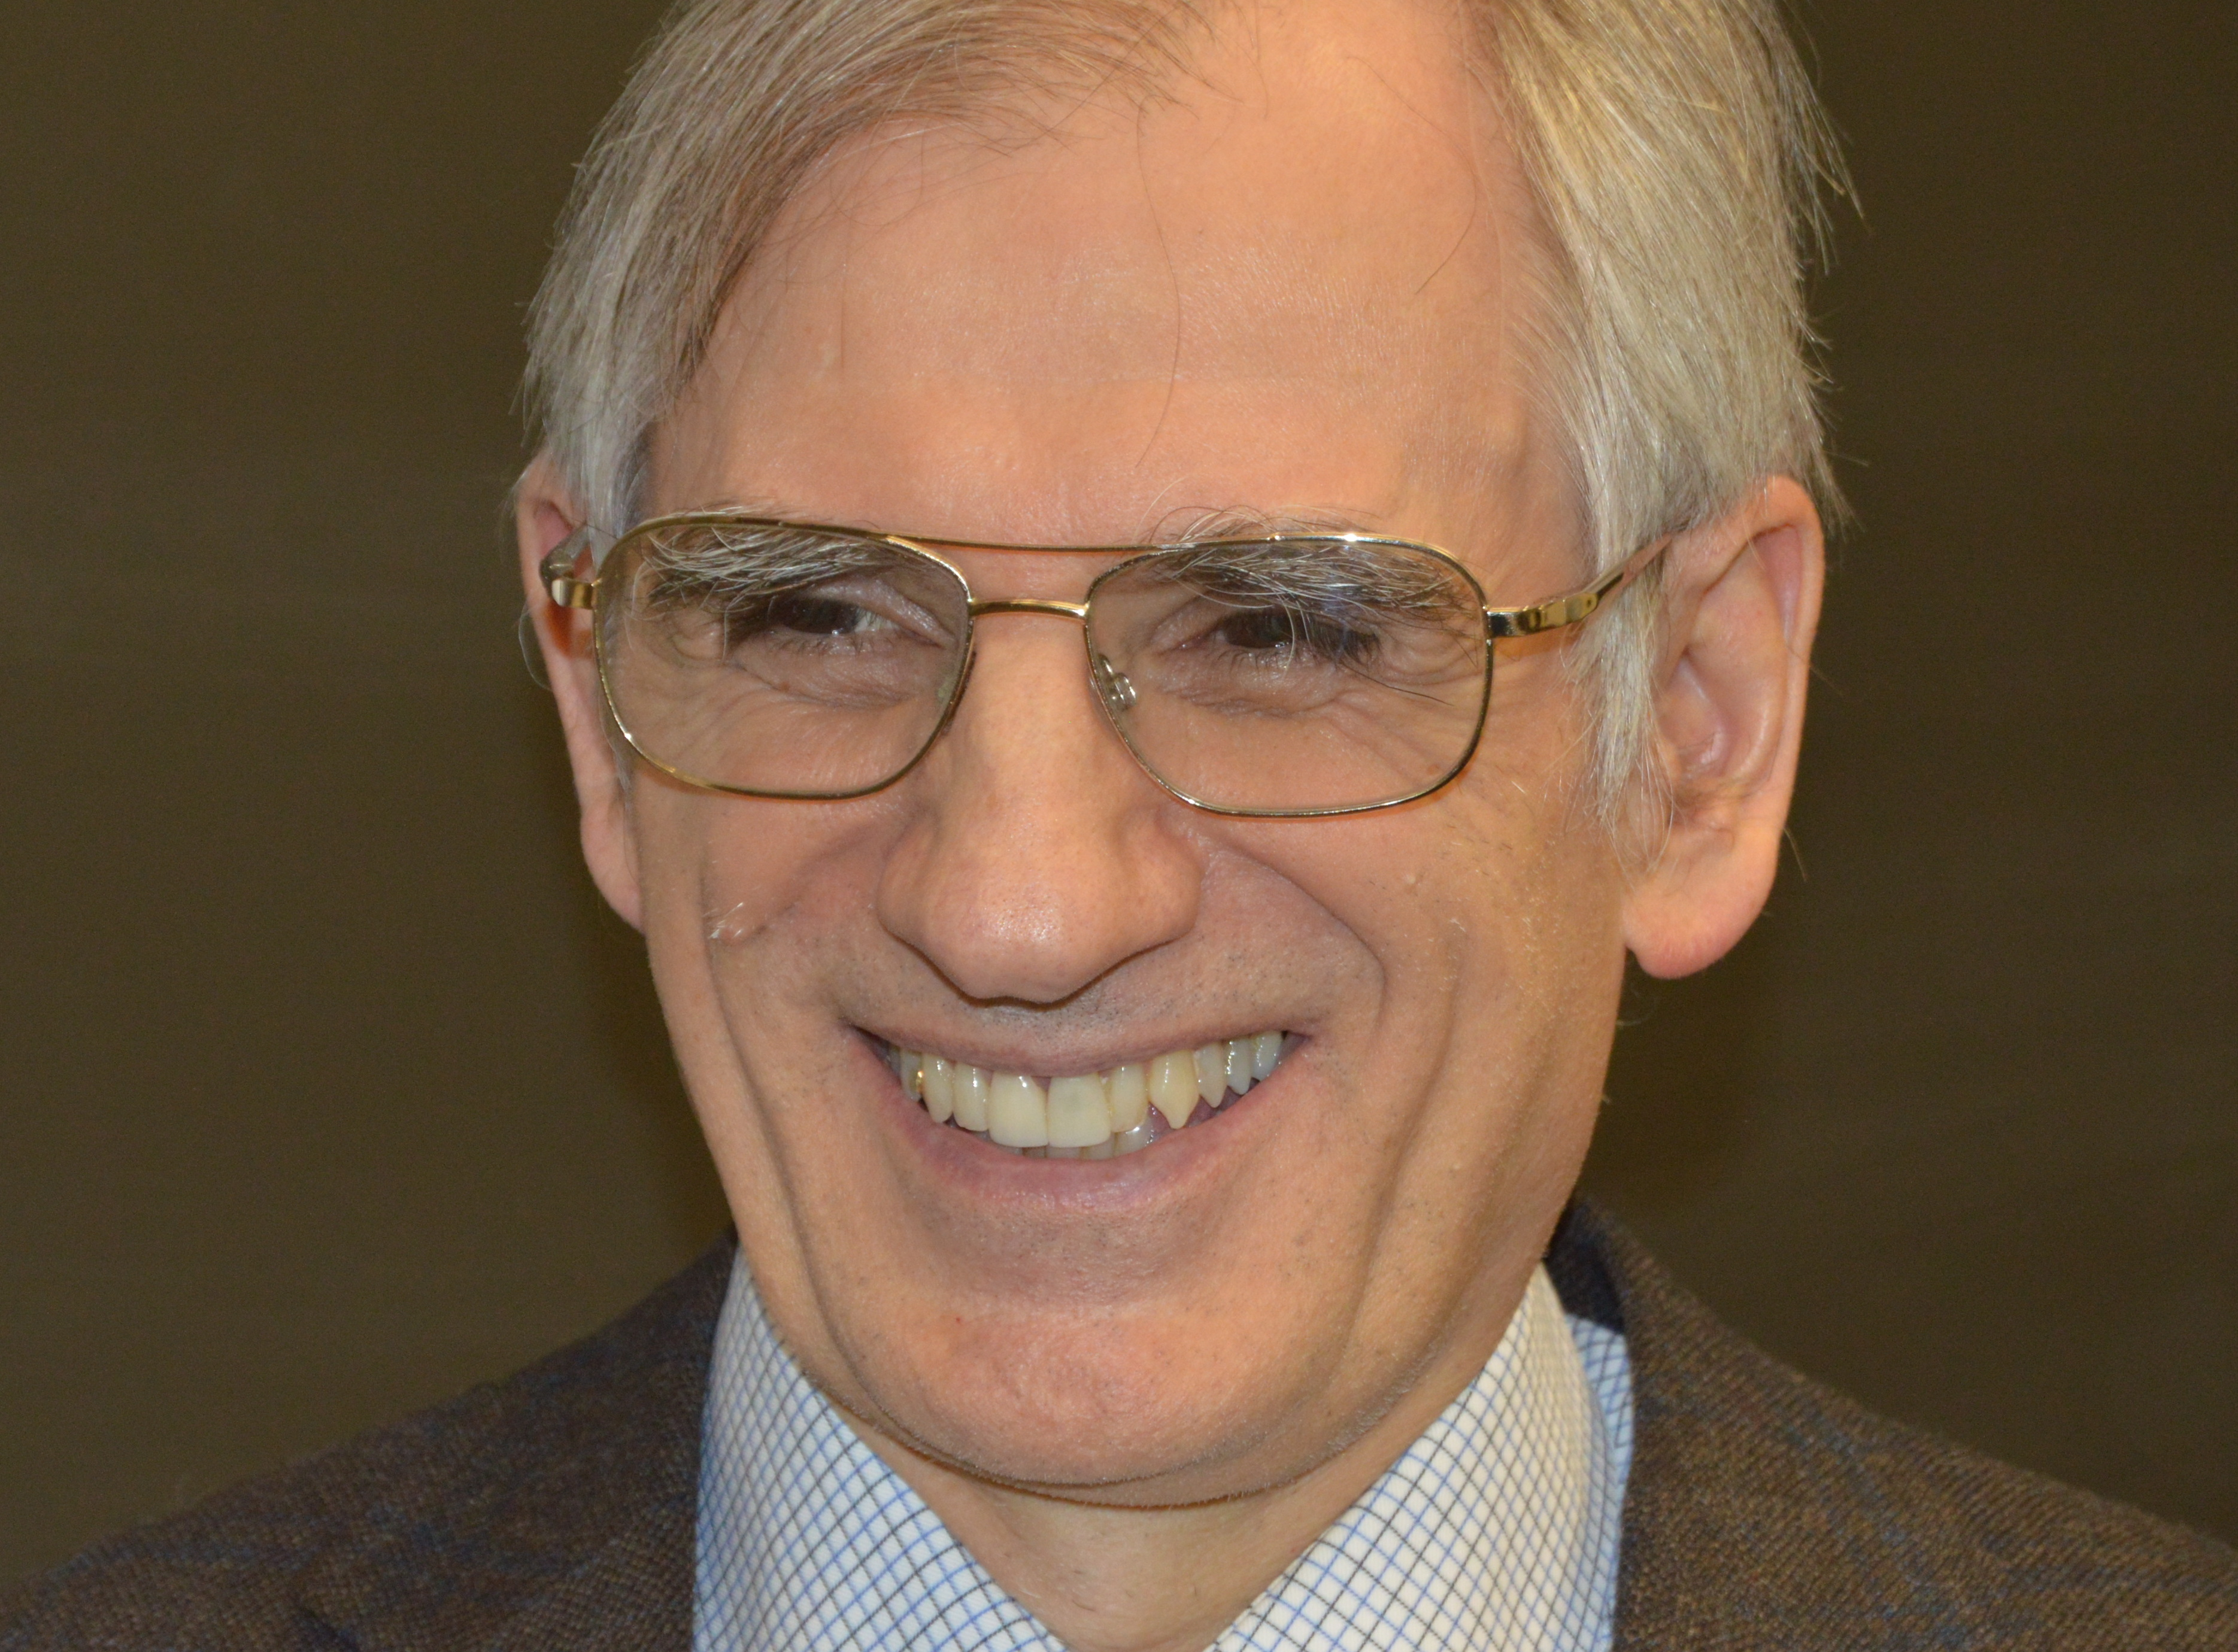
GRAPH ISOMORPHISM
Laszlo Babai -Born July 20, 1950 in Budapest, Hungary.Currently teaches at University of Chicago
Eugene M. Luks Born circa 1940
Showed isomorphism can be tested in polynomial time
Worked with Babai to create the lowest theoretical bound algorthim for graph isomorphism (1983)
One of Garey and Johnson’s 12 problems unknown to be NP-complete or in P
1980s - runtime 2O(√nlogn)
2015- Babai publishes a quasi-polynomial time algorithm exp(log(n)O(1))
2017 -Harald Helfgott discovers an error resulting in sub exponential time
Babai makes a revision to restore the quasi-polynomial claim

Slide 7
ISOMORPHISM DEFNATION
Suppose graphs G1 and G2 have vertex sets V1 and V2 and edge sets E1 and E2, respectively. Suppose further that there is a bijective (one-to-one and onto) function, or exact one-to-one correspondence,
f:V1→V2 such that {v1, v2} ε E1 if and only if {f(v1), f(v2)} ε E2. Then, G1 is isomorphic to G2.

Slide 8
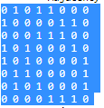
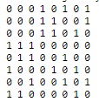
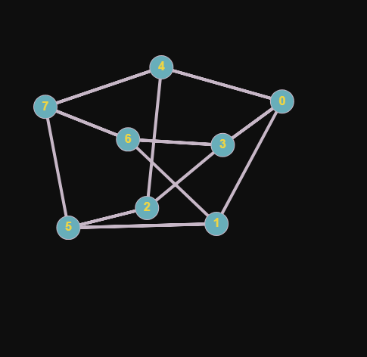
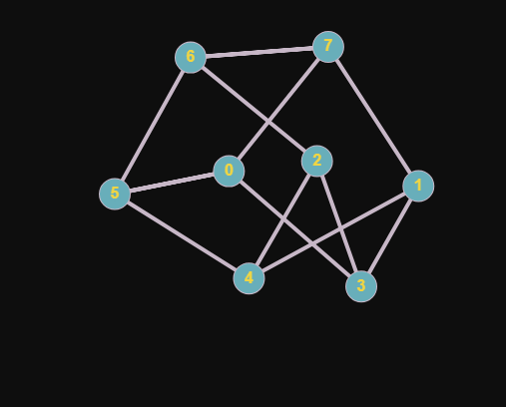
Three Degree Graphs

Slide 9
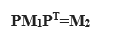
MY INITIAL APPROACH
STEP 1: Get the no of vertices
STEP 2: Get the identity matrix of NXN
STEP 3: Get permutation matrices from the Identity matrix
STEP 4: Transpose of permutation matrices
STEP 5: For Every Permutation matrix Do the multiplication of matrices as per the formula
STEP6: Compare the Resultant With first matrix.
STEP 7:END

Slide 10
Pseudo Code Of The Implementation
STEP 1: Enter the Adjacent Matrix for the Matrix M₁
STEP 2: Enter the Adjacent Matrix for the Matrix M₂
STEP 3: Check the degree of Matrix M₁
STEP 4: Check the Degree of Matrix M₂
STEP 5: Compare the Degree of Matrix M₁ and Matrix M₂
STEP 6: Get the Permutation of the indices of Matrices and store it temporarily
STEP 7: Get the upper triangle of the matrices
STEP 8: Apply the formula
Sum+=abs(M₁[K][L]-M₂[P[K]][P[L]])
STEP 9: If the sum ==0
then it is isomorphic
Else Non-Isomorphic.
STEP 10: Display the Corresponding edges and vertices which match.

Slide 11
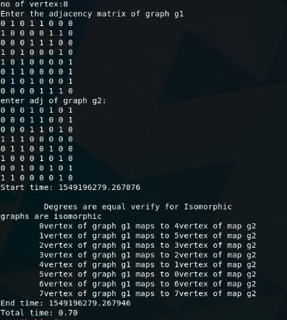
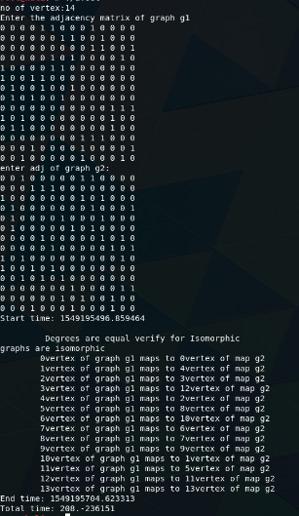
RESULTS

Slide 12
FINDINGS:
8x8 MATRIX takes lesser time like .50-.70
10X10 and 12X12 adjacent Matrices are taking significantly lesser time than 14X14
Time taken for 20X20 Matrix is based on the time taken by 14X14 matrix approximated to 22 minutes then for 20X20 it takes
((20!/14!)*22mins)/(60*24*365)=1061 years.
Based on Average of time taken by 7 tests of 14X14 it will be 796.4 years

Slide 13

QUESTIONS?

